Slide 1
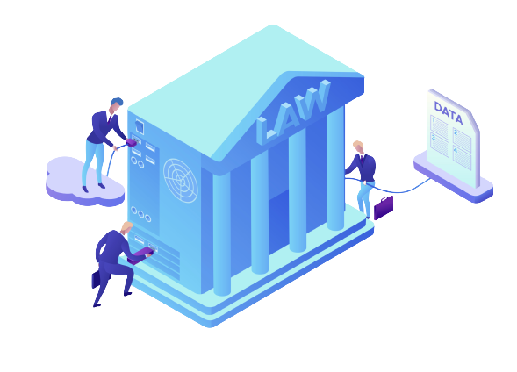
Privacy Law Association
General Meeting 10.16.23
Notes:
Thank people for coming; invite them to have pizza.

Slide 2
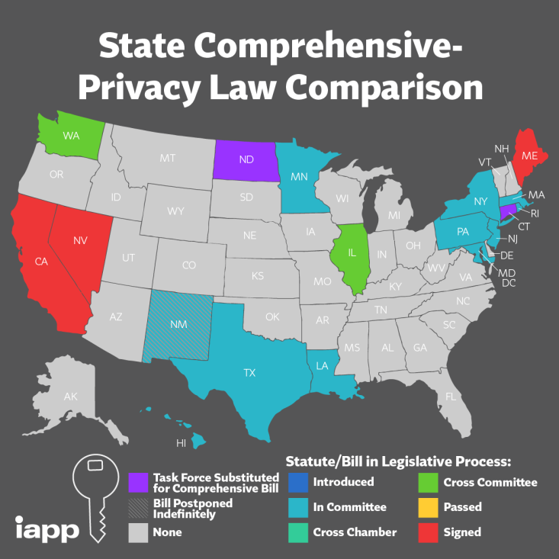
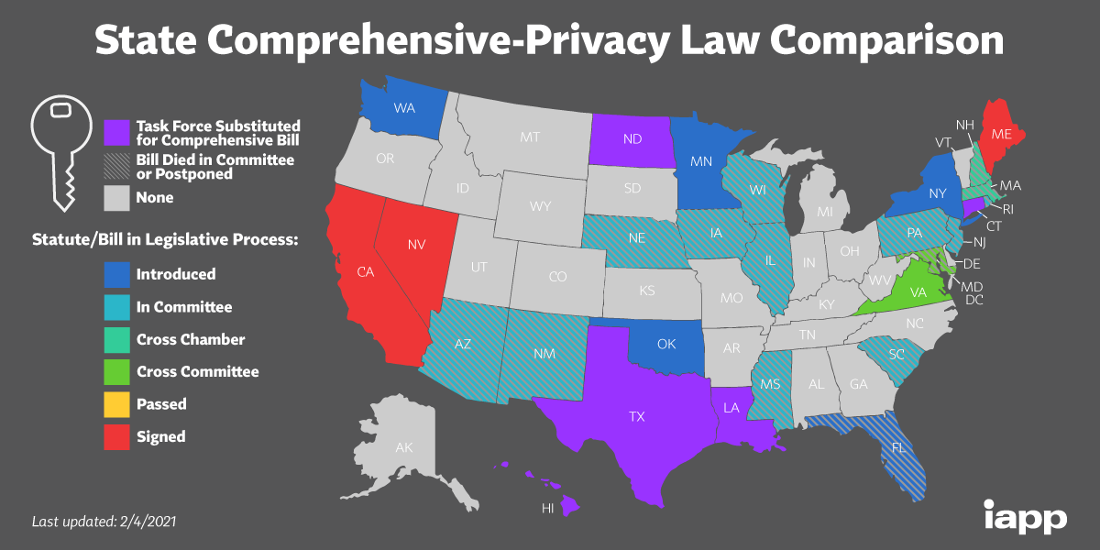
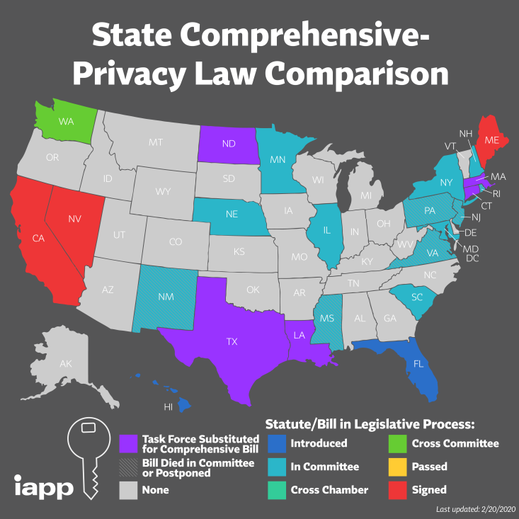
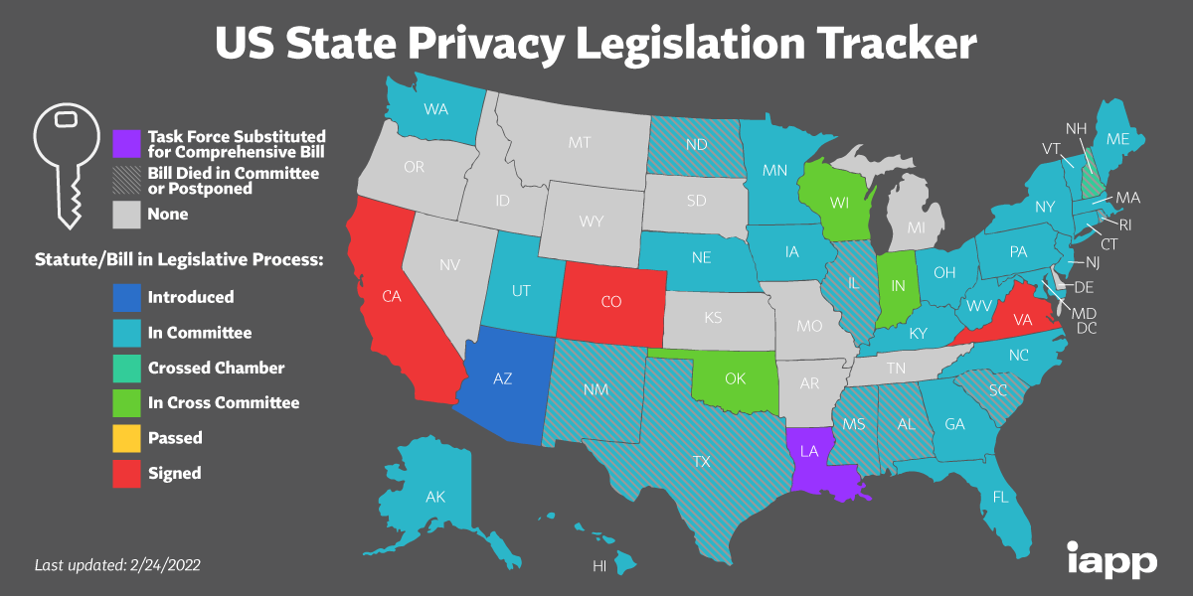
2019
2020
2021
2022
Notes:
Mention IAPP that put together these maps

Slide 3
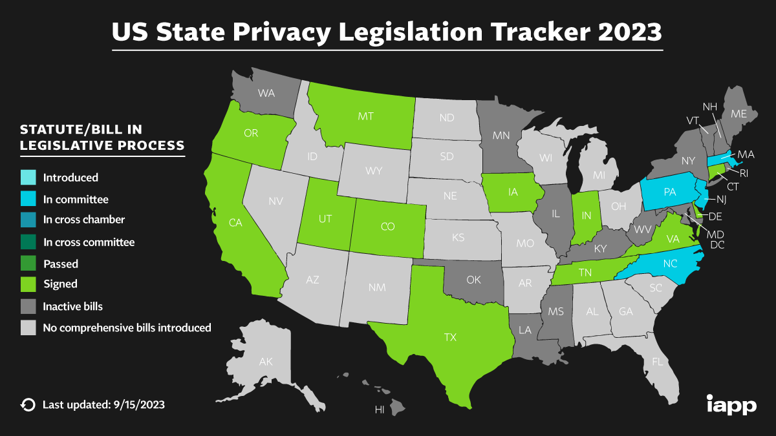
A Rapidly Changing Field
Notes:
Parallel with how new the PLA is; point out also that map is incomplete (Nevada)/inconsistent with prior years and only applies to the US

Slide 4
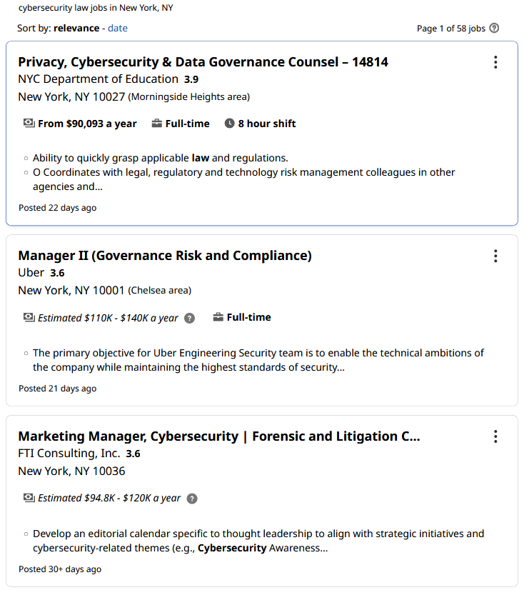
Career Opportunities
Notes:
This club is a little different; we’re here to get you in the field, with resources to put you a step ahead.
This slide is from last year and may need to be retired soon
Members of PLA’s former incarnation are now working in privacy
Other active professionals have expressed interest in coming back to talk at NYLS

Slide 5
The E-Board
Kyle Hunt, President
kyle.hunt@law.nyls.edu
Susan Distler, Vice President
susan.distler@law.nyls.edu
Cindy Park, Treasurer
cindy.park@law.nyls.edu
https://venmo.com/u/cindyypark
Britt Karen, Academic Chair
brittany.karen@law.nyls.edu
Jon Welgrin, Social Chair
jonathan.welgrin@law.nyls.edu
Kenny Santos
kenny.santos@law.nyls.edu
Notes:
Also mention faculty advisor, Michael Pastor; frame as “Who We Are”

Slide 6
Spring Thus Far
Esports Privacy and Compliance
Cybersecurity Happy Hour

Slide 7
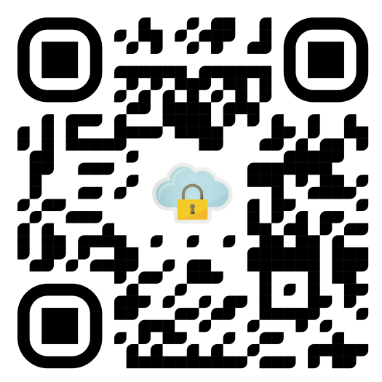
Fall Ahead:
Data Breach Tabletop CLE
CIPP Mentorship
Privacy Law Resources
Notes:
CIPP costs $550

Slide 8
What Does Privacy Mean?
Notes:
Interested in what privacy means to you;
Ask if members have interest in particular applications of privacy law, particular speakers they want to see, etc.

Slide 9
Thanks for Coming!
Remember to sign up for the CIPP!
https://privacylawnyls.com/cipp-interest
___________________________________________________
NYLS Privacy Law Association
eboard@privacylawnyls.com
@privacylaw_nyls
@privacylaw_nyls
https://privacylawnyls.com
Contact Us:

